Slide 1
Cubesat mission to study venus’ atmosphere
Exploring venus’ upper atmosphere with a compact satellite
Presented by :- milind , Kaustubh & omkar

Slide 2
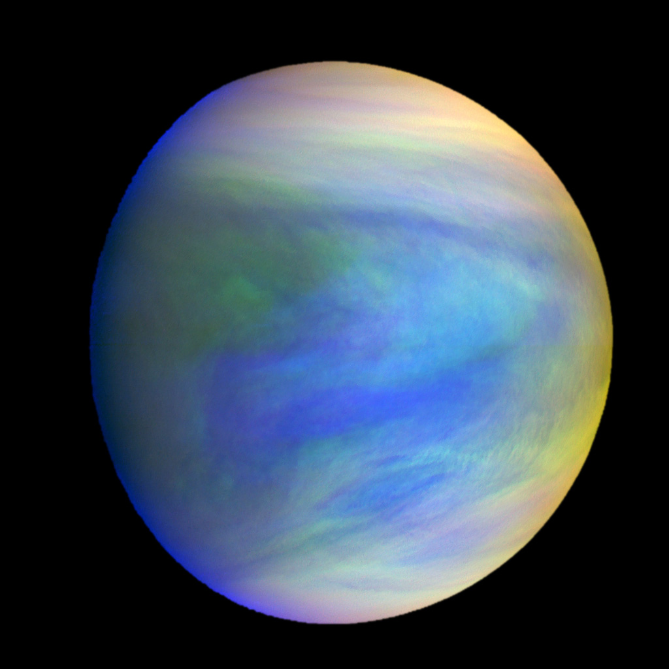
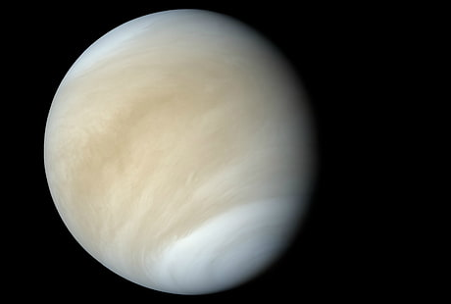
venus
Thick clouds of venus reflects most of the sunlight(visible light) that falls on them. Venus is almost featureless in visible.
50% of the solar energy received by venus is absorbed in uv by an unidentified absorbers in the top cloud layer.
In the uv we observe dark & light regions.
Clouds top structure and uv absorbers nature are key parameters for understanding the atmosphere of venus
We know different molecules absorbs different uv of different wavelength.
Therefore we need venus’ uv spectrum & uv imaging to study its atmosphere.

Slide 3
Mission overview
Objective: study the upper atmosphere and cloud layers of venus.
Importance: understanding atmosphere composition , dynamics ,and potential climate parallels with earth.
Mission goal: gather data to enhance knowledge of venus’ climate and its evolution.

Slide 4
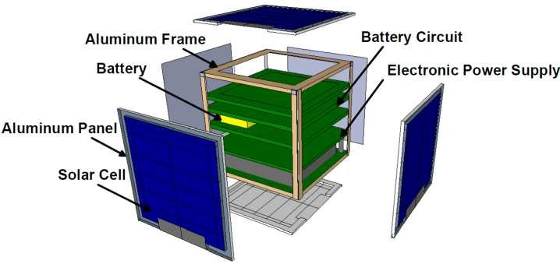
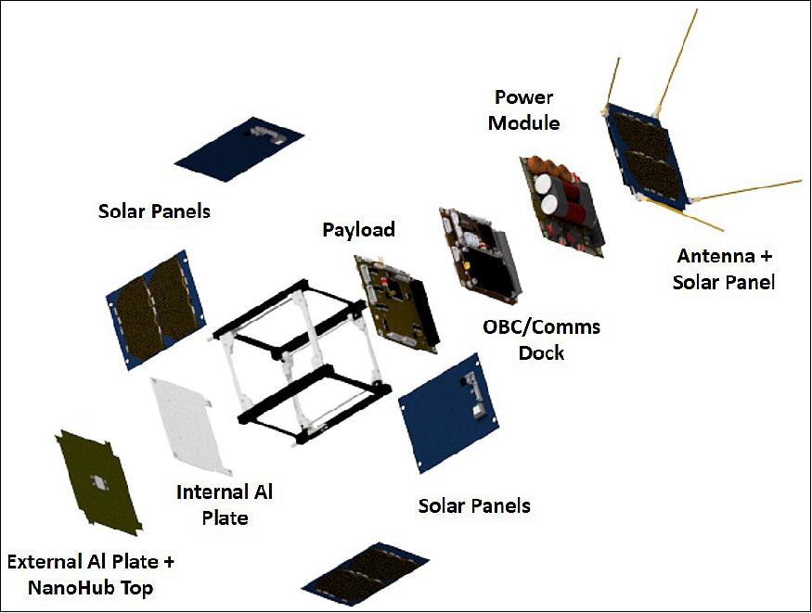
Mission design and orbit
Size of cubesat :- 15cm x 15 cm x 15cm
Structure -> alluminium 6082 alloy
Component of cubesat:-
cubesat plateform
Payload :- 1) uv spectrometer
2) uv multispectral imaging
Solar panels & power system
Attitude determination & control system
Communication system
Thermal control system
On board computer(obc)

Slide 5
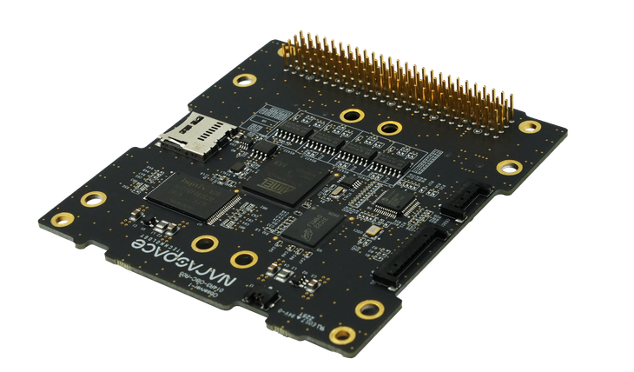
Obc(on board computer)
Obc is the brain of the computer
It manages the satellite when it’s not in the sight of ground station
Payload operation
Safety operation – thermal control

Slide 6
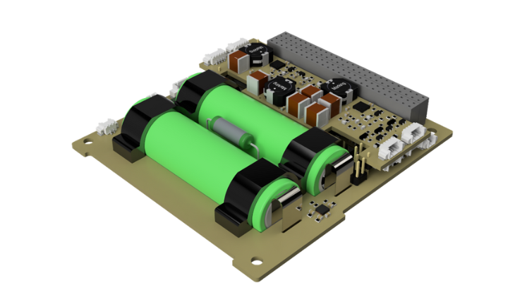
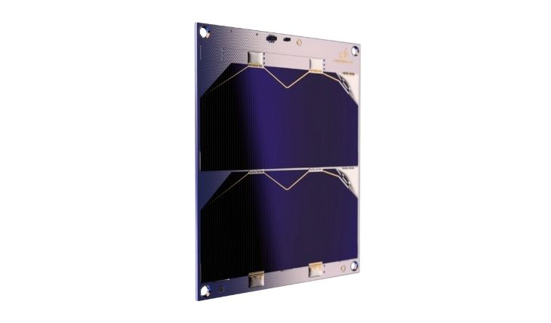
Power
1) Solar panels : generates power
2) Battery(Li-ion) : stors
3) Electrical power system: power distribution unit (supply)
power control unit (control)
include voltage converters, sensors

Slide 7
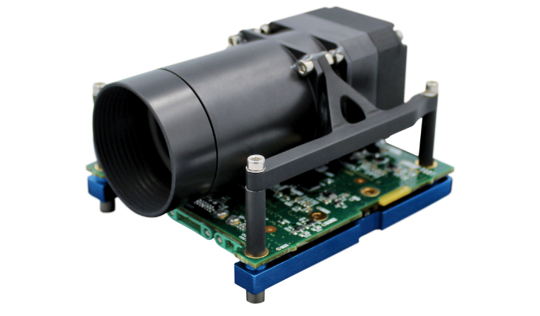
sensors
Uv imaging spectrometer : observe & measure uv light in venus’ atmosphere.
Solar radiation sensors : helf differentiate between solar uv light & atmosphere emission.
Attitude control sensors : sun sensors , magnetometers & gyroscope.

Slide 8
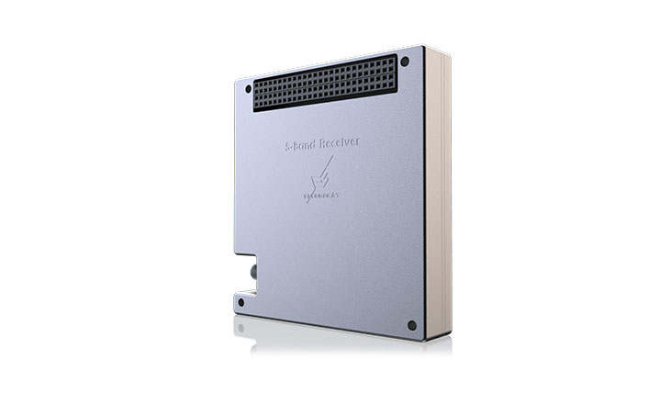
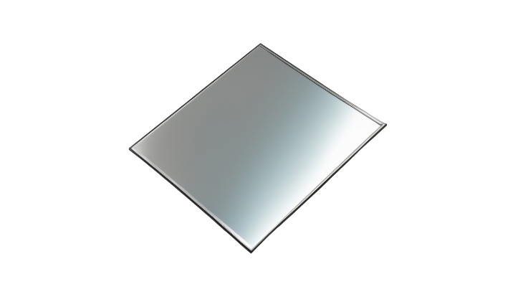
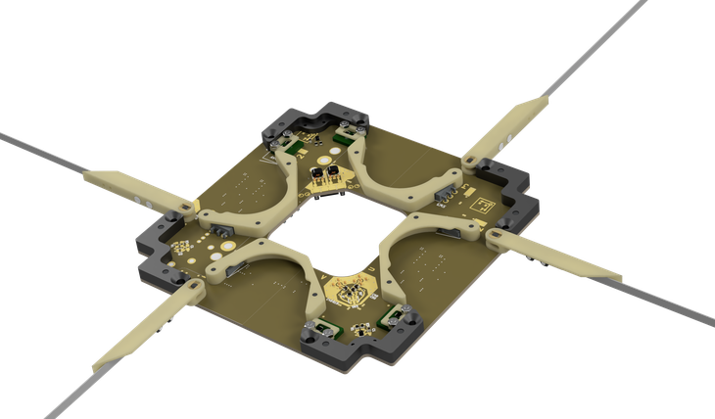
Communication
Radio transmitter and receiver
Antenna system
Telemetry system

Slide 9
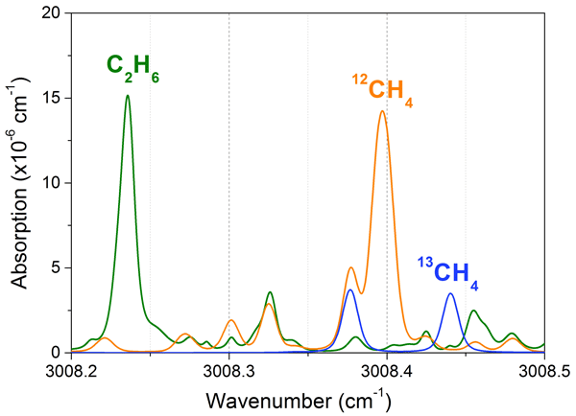
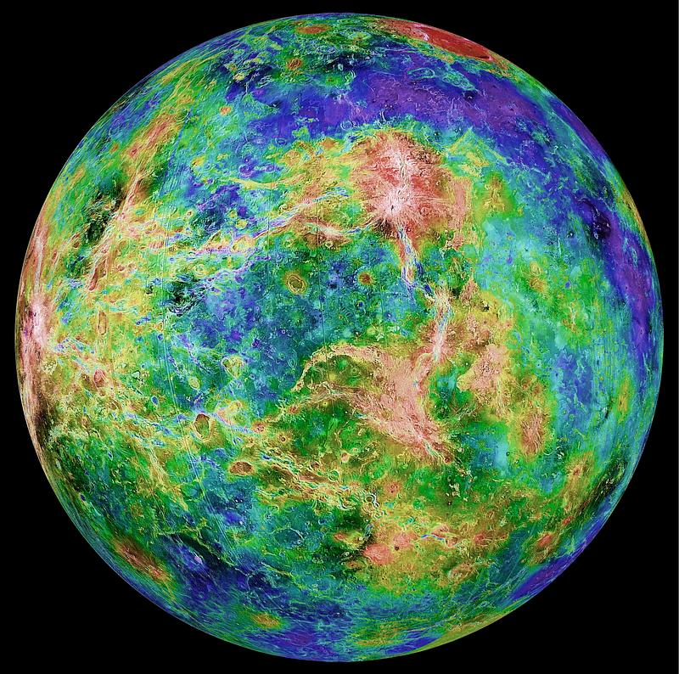
Payload : (collection of data)
Uv component
uv spectrometer
Uv multispectral imaging
Image with different wavelength :
Shows absorbers distribution in atmosphere
Structure of cloud & dynamics
Detecting & analysing electromagnetic radiation :
Molecules presents in the atmosphere

Slide 10
Known uv absorbers
Known absorbers :
SO2 varies from 0.1 to 1 ppm at the cloud top
SO about 30% of SO2
Other Sulfur bearing species ‐ sulfur Sx, S8, S2O, OSSO – FeCl3
Recently :
Messenger MASCS found best fit for S2O and OSSO
Messenger MASCS found best fit for S2O and OSSO
Other proposed absorbers:
SCl2, Cl2 and many others (C3O2, CH2O, NOHSO4, NO2 , N2O4, NH3NO2, (NH4)2SO4, (NH4)S2O5, NH4Cl, Cl2, SCl2, HClO4)

Slide 11
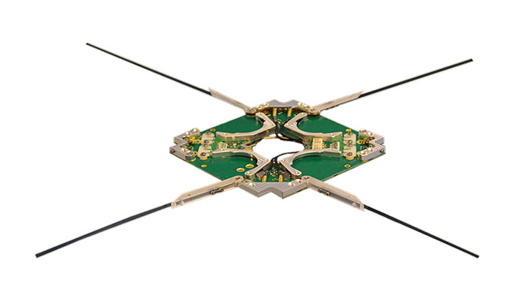
Transmition of data
Transmition of data is done with the help of radio waves
Transmitted from the antennas of the cubesat and received by DSN(deep space network)
Mass (0.085kg)

Slide 12
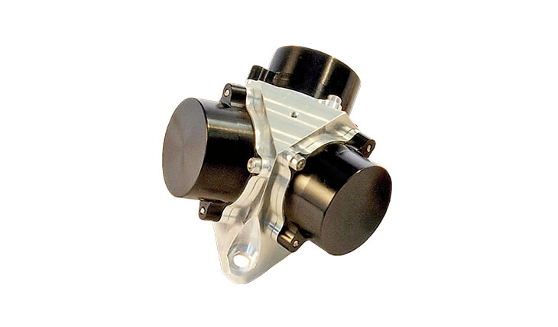
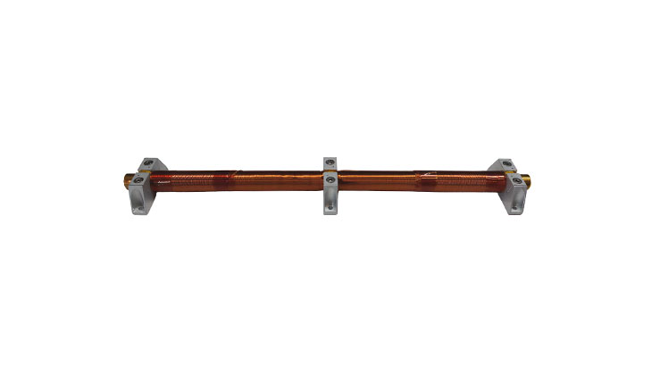
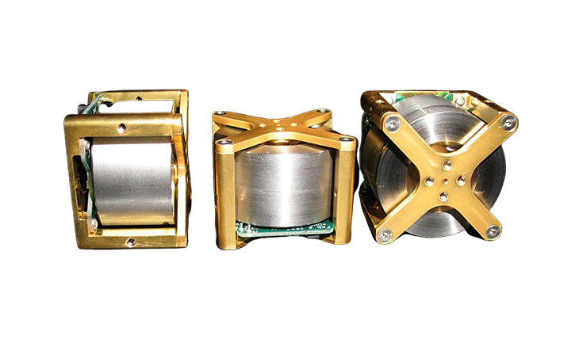
Maintaining of altitude
High altitude orbit must be chosen to avoid atmospheric drag from venus’ thick atmosphere
Orbit stabilization and control :
Reaction wheel (0.081 kg, 0.62W)
magnetorques (0.053kg, 0.8W)
Thrusters

Slide 13
Weight calculation
Structure (aluminium/carbon fibre) | x2 | 200g
Power system | Solar panel x 2 Batteries(Li-ion) x 1 | 50g 150g
obc | 1 | 50g
Communication system | Tansmitter/receiver x 1 Antenna(UHF/VHF) x 1 | 100g 20g
Thermal control system | 1 | 50g
Attitude determination & control system(ADCS) | magnetorques/gyroscope | 100g
Deployment mechanism | 1 | 30g
payload | Uv spectrometer Uv multispectrometer imaging | 500g
 | Total mass | 1.15 kg

Slide 14
challenges
1) Over heating of solar panels :
we need proper orientation to avoid over heating.
2) Delay/fail in transmitting data :
due to large distance between earth and venus strength of signal would be weak & delay in data transmittion may occur
Small size of cubesat may limit the power generation, which could restrict the amount of data that can be transmitted.
Cubesats have a very limited data return capability because of limited antenna aperture size and power
3) Shielding failure : Radiation from the sun can damage the electronics
4) Accidental discharge of battery :
May cause premature activation.
Reachargeable batteries must be fully discharged or deactivated during the launch

